Slide 1
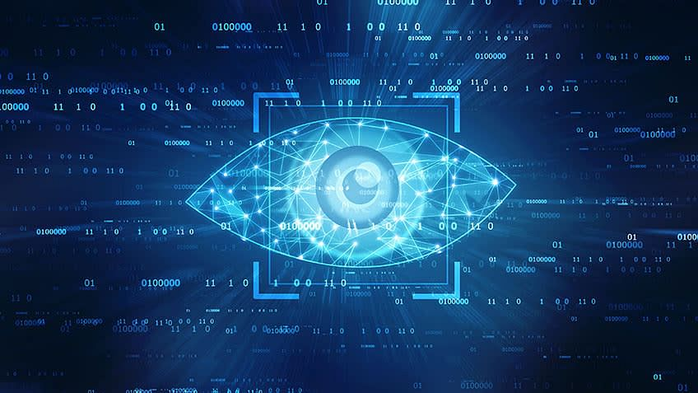
CSE 410 Computer Vision

Slide 2
Computer Vision
Computer vision is a field of artificial intelligence (AI) that enables computers and systems to derive meaningful information from digital images, videos and other visual inputs

Slide 3
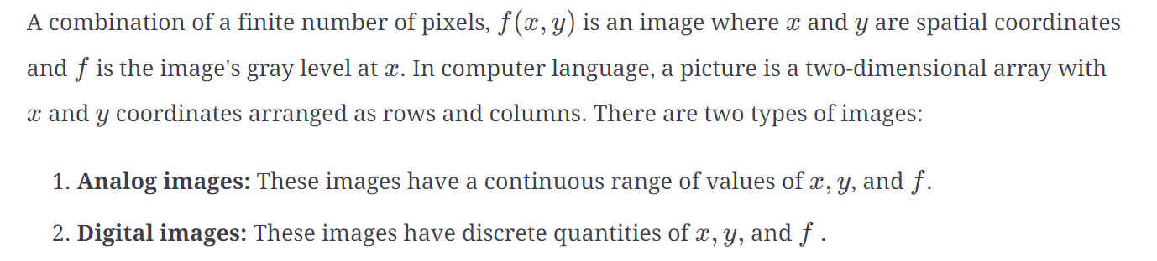
What are digital images?

Slide 4
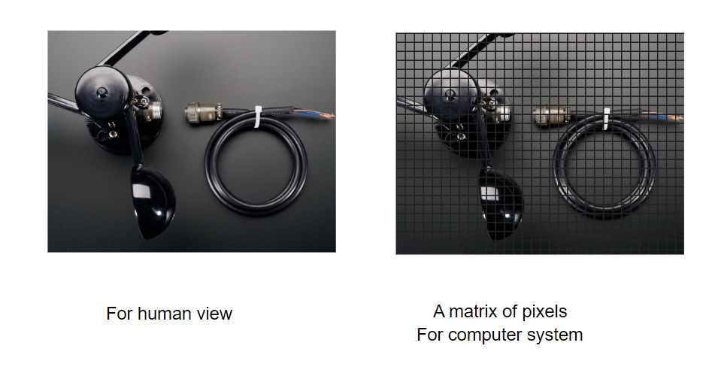
Pixels
A digital image contains a finite set of elements called pixels. They are also known as picture elements or image elements.
An image is represented in the form of a matrix where each element consists of single pixels. Each pixel is the smallest point on the image that takes on a particular opacity, colour, or shade.
Let's say we have an image with a size of 200 x 200 (width x height). The total number of pixels in the picture is 400000.

Slide 5
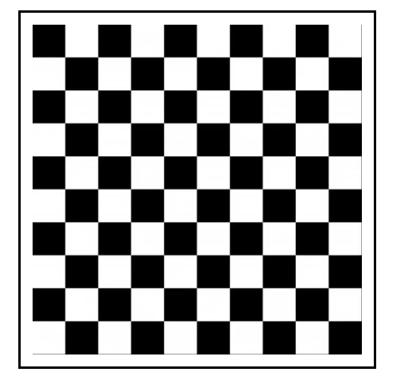
Types of digital images
Binary images
The binary images only have two-pixel elements, 0 and 1. 0 represents black entirely and 1 represents white.

Slide 6
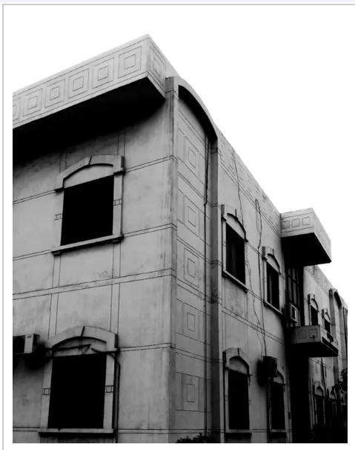
Types of digital images
Grayscale images
In a grayscale image, the pixel is an integer value between 0–255. Zero is entirely black, and 255 is white. Gray falls around 127 leading to the white color. These images are also known as 8-bit color format images.

Slide 7
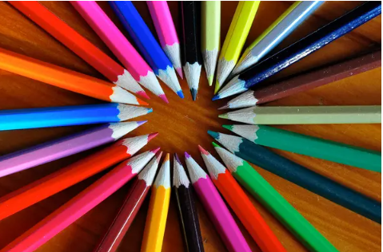
Types of digital images
RGB images
In RGB images, a pixel consists of three integers; the value range is 0 to 255. These images are made up of three primary RGB colors.
These images are represented in a 3-D matrix or a 3-dimensional array. These images use the high-colour format known as the 16-bit colour format.

Slide 8

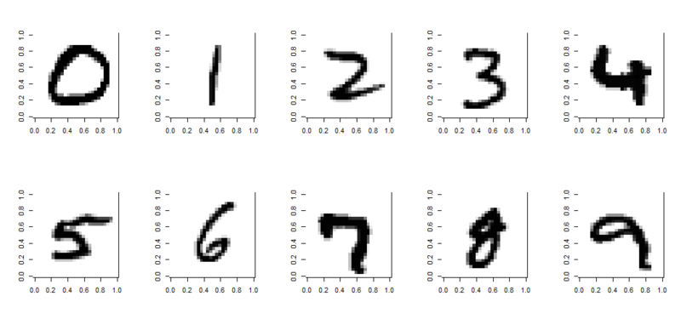
Let’s imagine we have a simple image of a handwritten number:
Each single-digit image can be represented as an array

Slide 9
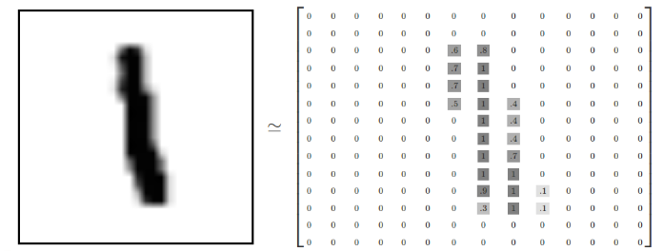
For example, here a number is 28 by 28 pixels

Slide 10

Now that we’ve understood how grayscale images can be represented as arrays, what about colour images?
Color images can be represented as a combination of Red, Green, and Blue.
Additive color mixing allows us to represent a wide variety of colors by simply combining different amounts or R, G, B.
Each color channel will have intensity values.
http://www.cknuckles.com/rgbsliders.html

Slide 11
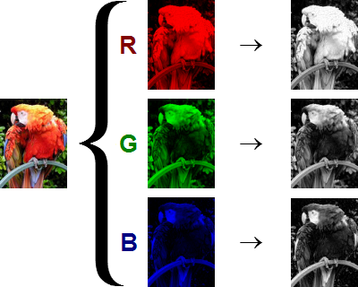
The shape of the color array then has 3 dimensions.
Height
Width
Color Channels
This means when you read in an image and check its shape, it will look something like:
(1280,720,3)
1280 pixel width
720 pixel height
3 color channels

Slide 12
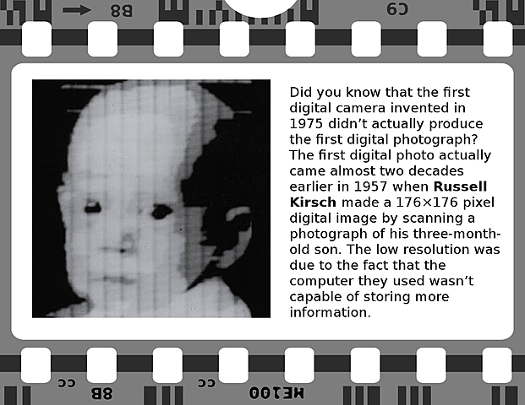
FIRST DIGITAL IMAGE

Slide 13
How many pixels in an image are 800 pixels wide, and 600 pixels high? - just multiply - 800 x 600 = 480,000 pixels = 0.48 megapixels

